Slide 1
Windows 10 IOT + Raspberry Pi 2
Mail: krzysztof.krzyskow@gmail.com
Twitter: @KrzyskowK
Github: ChrisOrTwo
Internet Of Things by Microsoft

Slide 2
What is Windows 10 IoT Core?
https://dev.windows.com/en-us/iot

Slide 3
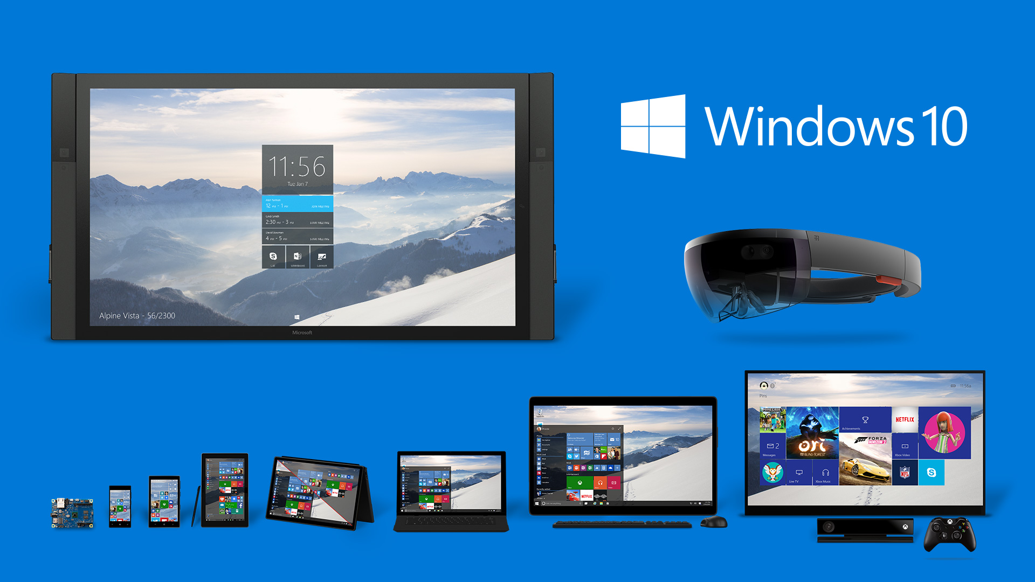
What is Windows 10 IoT Core?
Notes:
Windows 10 IoT Core is a version of Windows 10 designed specifically for use in small footprint, low-cost devices and IoT scenarios.
rebranded version of Windows Embeded.
No UI Shell (no task manager/no rdp/no windows explorer/no media player) NOTHING!
Due to fact that Windows 10 IoT Core supports also ARM architecture not all drivers (so devices as well) that work with Windows 10 are supported in IoT Edition
You can run it on different architecture than x86/x64

Slide 4
What is Windows 10 IoT Core?
HARDWARE REQUIREMENTS:
PROCESSOR: 400 MHz (x86/ARM)
MEMORY: 256 MB (128 MB for OS) - headless mode 512 MB (256 MB for OS) - headed mode
STORAGE: 2 GB
SUPPORTED HARDWERE:
http://ms-iot.github.io/content/en-US/win10/SupportedInterfaces.htm

Slide 5
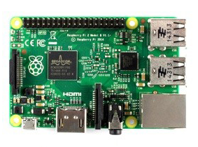
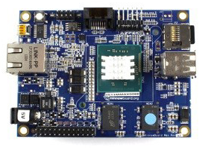
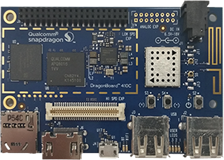
What is Windows 10 IoT Core?
SUPPORTED HARDWARE:
Raspberry PI 2 MinnowBoard MAX Galileo DragonBoard
Notes:
MinnowBoard
Qualcom DragonBoard 410c
- Intel Galilieo not supported since 30 Nov 2015 (due to week performace (only 400MHz CPU))

Slide 6
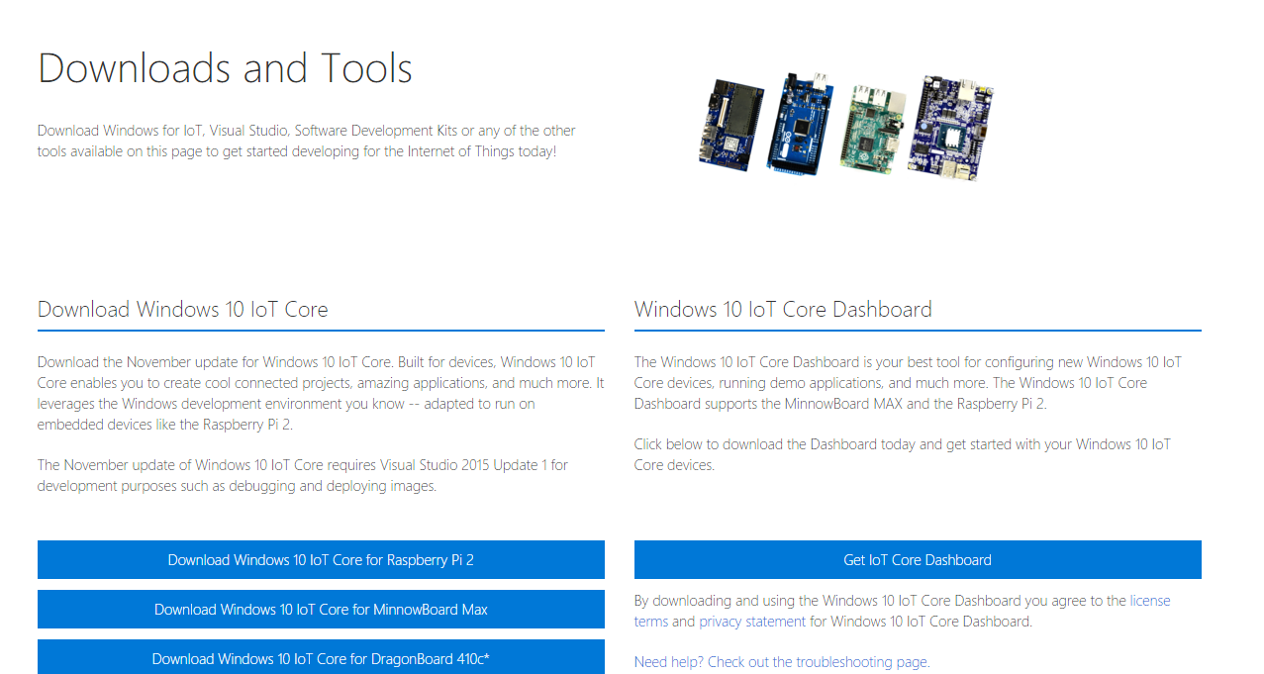
How to install Windows 10 IoT Core?
http://ms-iot.github.io/content/en-US/Downloads.htm
Notes:
Two ways of installation:
1) Manual: Download .iso with flash and WindowsIoTImageHelper – that allows to create Windows 10 IoT instance on you SSD card
2) Download Windows IoT Dashboard. Select device type and it will continue for you
Show website
Show IoT Dashboard

Slide 7
How to manage?
Windows Device Portal
Powershell
SSH
FTP
Windows File Sharing

Slide 8
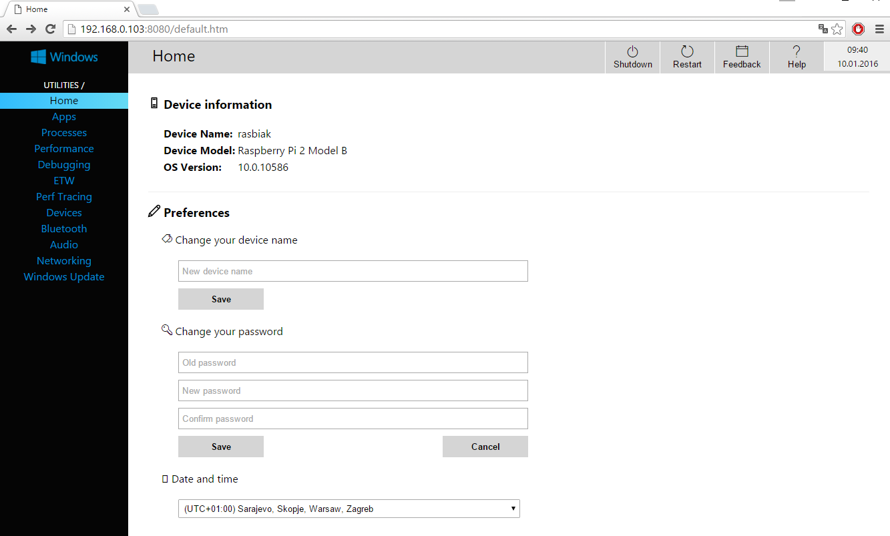
How to manage?
WINDOWS DEVICE PORTAL
Port: 8080

Slide 9

How to manage?
POWERSHELL
Run Powershell console in Administrator Mode
Run WinRM service:
net start WinRM
Set IoT device as trusted host:
Set-Item WSMan:\localhost\Client\TrustedHosts -Value <iot-name or IP Address>
Start remote session:
Enter-PSSession -ComputerName <iot-name or IP Address> -Credential <iot-name or IP Address or localhost>\Administrator

Slide 10
How to manage?
COMMAND LINE UTILS
Setting startup app:
IotStartup list - list installed applications
IotStartup list headed - list installed headed applications
IotStartup list headless - list installed headless applications
IotStartup list MyApp - list installed applications that match pattern MyApp
IotStartup add headed MyApp - register for startup headed application that matches pattern MyApp
IotStartup add headless Task1 - register for startup applications that match pattern Task1
IotStartup remove headless Task1 - remove headless applications that match pattern Task1
IotStartup startup - list headed and headless applications registered for startup
IotStartup startup MyApp - list headed and headless applications registered for startup that
IotStartup startup headed MyApp - list headed applications registered for startup that match MyApp
IotStartup startup headless Task1 - list headless applications registered for startup that match Task1

Slide 11
How to manage?
COMMAND LINE UTILS
Set display resolution:
SetDisplayResolution [width] [height]
Shutdown:
shutdown /s /t 0
Restart:
shutdown /r /t 0
Boot Options (headed / headless):
setbootoption.exe [headed | headless]
More:
http://ms-iot.github.io/content/en-US/win10/tools/CommandLineUtils.htm

Slide 12
How to manage?
FTP
Open (via file explorer):
ftp://<device-ip-address>
Ftp server process:
ftpd.exe
Changing root directory:
kill –processname ftpd* start C:\Windows\System32\ftpd.exe <New-root-directory-path>
For permanent changes (edit file):
System32\IotStatrtupOnBoot.cmd

Slide 13
How to manage?
Windows File Sharing
Open (via file explorer):
\\<device-ip-address>\c$
File sharing service:
Server
For permanent start/stop:
reg add HKEY_LOCAL_MACHINE\SYSTEM\CurrentControlSet\services\lanmanserver /v Start /t REG_DWORD /d 0x3 /f
reg add HKEY_LOCAL_MACHINE\SYSTEM\CurrentControlSet\services\lanmanserver /v Start /t REG_DWORD /d 0x2 /f

Slide 14
How to develop an application?

Slide 15






How to develop an application?
Supported Languages:

Slide 16





How to develop an application?
Supported development OS:
UWP
UNIVERSAL WINDOWS PLATFORM
Notes:
- Before we start from OS we need to clarify on keyword
- Keyword: Universal Windows Platform - Universal Apps

Slide 17
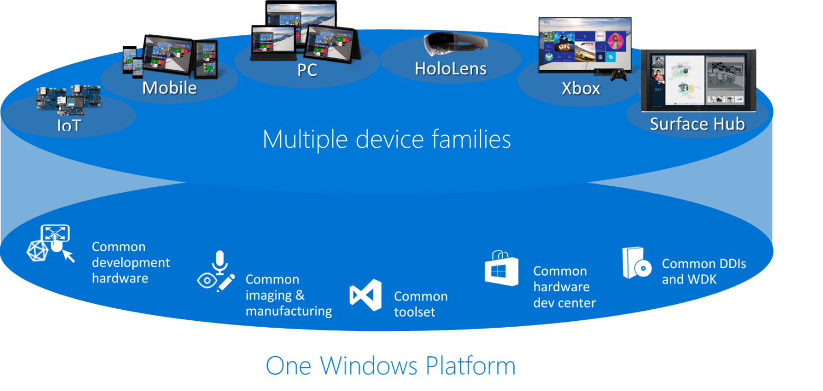
How to develop an application?
Universal Windows Platform
Notes:
- Universal platform is environment supported by all windows 10 distrybutions
- It means

Slide 18
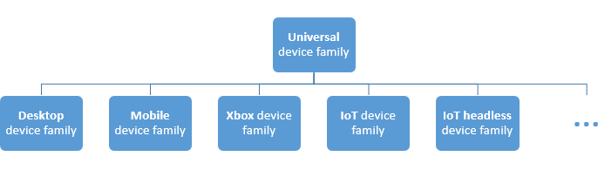
How to develop an application?
Universal Windows Platform

Slide 19
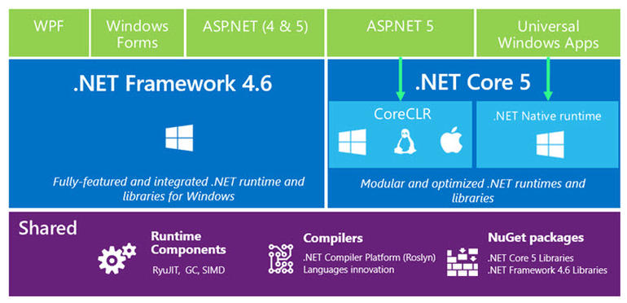
How to develop an application?
Universal Windows Platform

Slide 20

How to develop an application?
Universal Windows Platform

Slide 21
How to develop an application?
Supported development OS:
UWP
UNIVERSAL WINDOWS PLATFORM

Slide 22
How to develop an application?
Standalone DNX application

Slide 23
How to develop an application?
Standalone Node application
Download ARM Node.js build
https://github.com/ms-iot/ntvsiot/releases
Copy node.exe to device (i.e. C:\Node)
Setup firewall rule
netsh advfirewall firewall add rule name="Node.js" dir=in action=allow program="C:\Node\node.exe" enable=yes

Slide 24
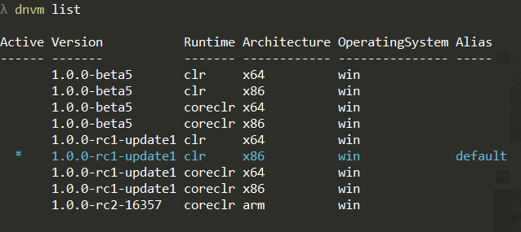
How to develop an application?
Standalone C# DNX application
Install DVNM (.Net version manager) on development machine
Windows: http://docs.asp.net/en/latest/getting-started/installing-on-windows.html
Linux: http://docs.asp.net/en/latest/getting-started/installing-on-linux.html
OSX: http://docs.asp.net/en/latest/getting-started/installing-on-mac.html
Update DVNM and download ARM coreCLR
dnvm update-self dnvm install latest -r coreclr -arch ARM -u
Check if ARM coreCLR has been correctly installed
dnvm list

Slide 25
How to develop an application?
Standalone C# DNX application
Create .NetCore project via VS2015 (Windows) or generate with Yeoman (Linux/OSX/Windows)
Rebuild project
Publish package in ARM runtime (Run in you project.json location)
dnu publish --out <output_dir> --no-source --runtime dnx-coreclr-win-arm.1.0.0-rc2-16357
Copy <output-dir> to IoT device directory
Run yourApplicationName.cmd from main path

Slide 27
What is Windows 10 IoT

Slide 28
Title and content layout with chart

Slide 29
Two content layout with table
First bullet point here
Second bullet point here
Third bullet point here
 | Group 1 | Group 2
Class 1 | 82 | 95
Class 2 | 76 | 88
Class 3 | 84 | 90

Slide 30
Title and content layout with SmartArt
Step 1 Title
Task description
Step 2 Title
Task description
Step 3 Title
Task description

